Slide 1
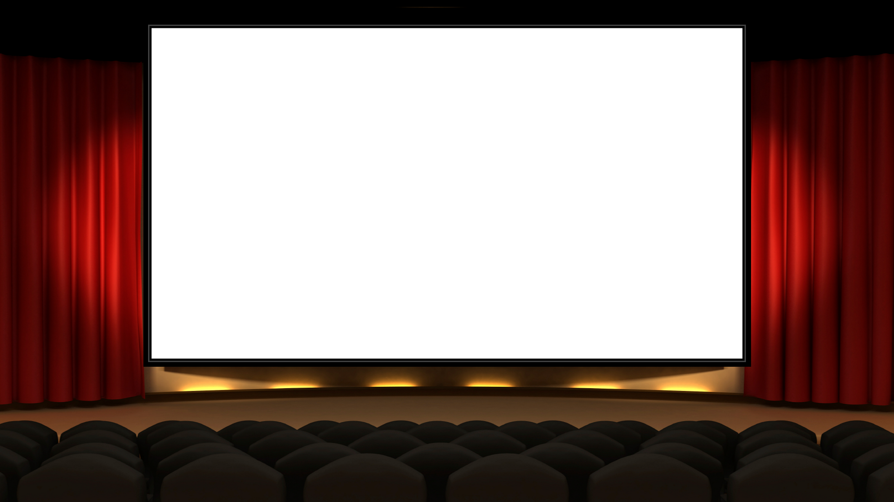

Final Project
By Team 1 -
Tom, Fowsia,Guv, Rayyana and Jasmin

Slide 2

Project Introduction:
Overall objective:
To create a full-stack Web application suitable for QA Cinemas, with utilisation of supporting tools, methodologies and technologies that encapsulate all modules covered during training.
Technologies used:
Version Control System - Git
Source Code Management - GitHub
Kanban Board - Jira
Full-Stack Development Technologies: MERN Stack
Database Management System - MongoDB
Back-End Programming - Node
API Development Platform - Express
Front-End Development Framework - React
Unit Testing - Mocha, Chai

Slide 3
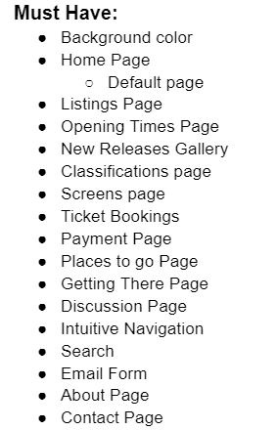
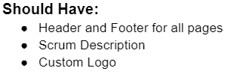
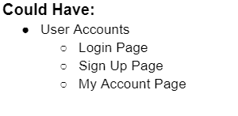
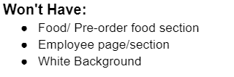
MVP:

Slide 4
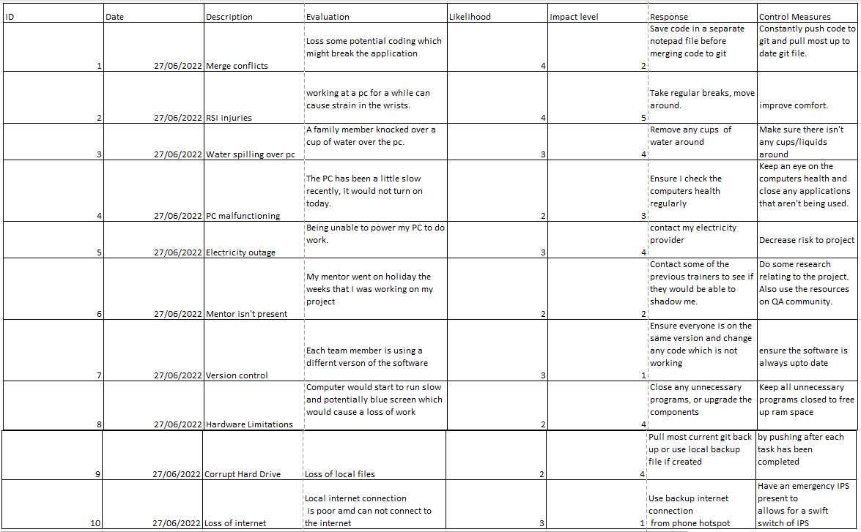
Risk Matrix

Slide 5
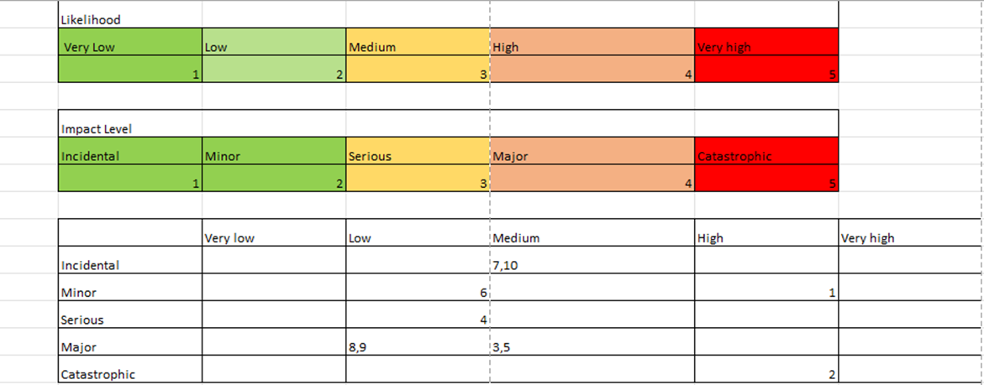
Risk Matrix

Slide 6
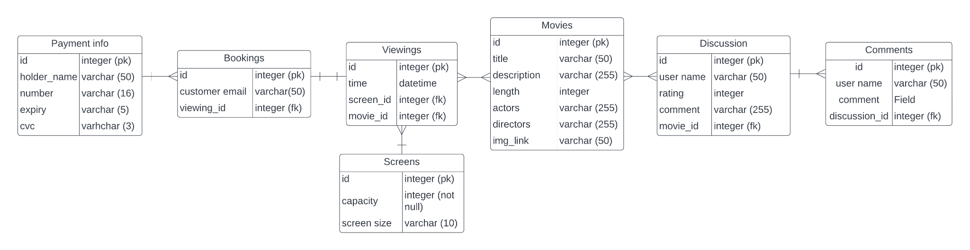
ERD -Initial

Slide 7
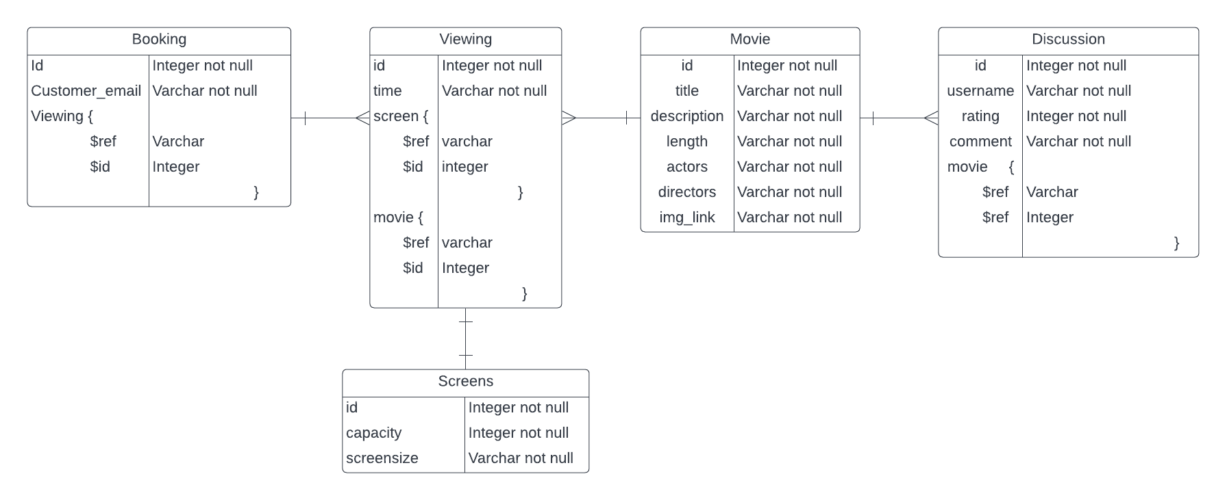
ERD After

Slide 8
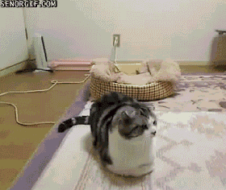
Morning Stand ups

Slide 9
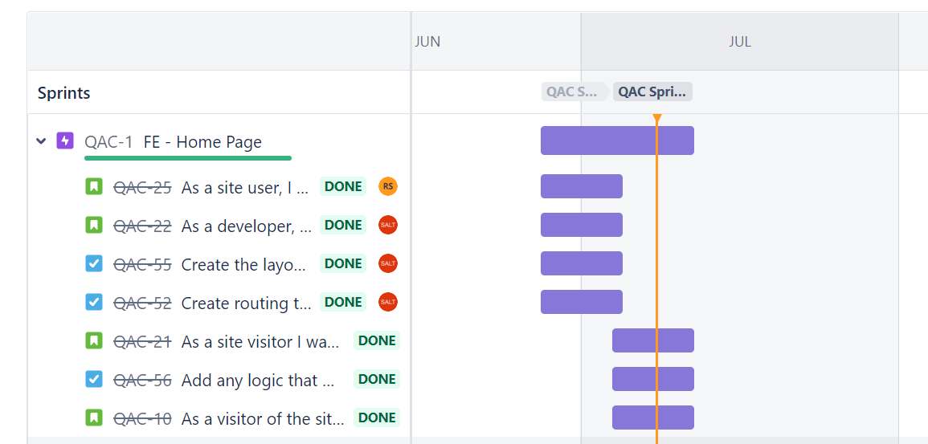
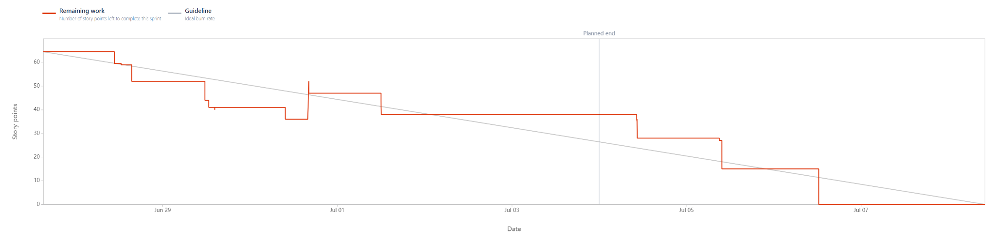
Jira

Slide 10
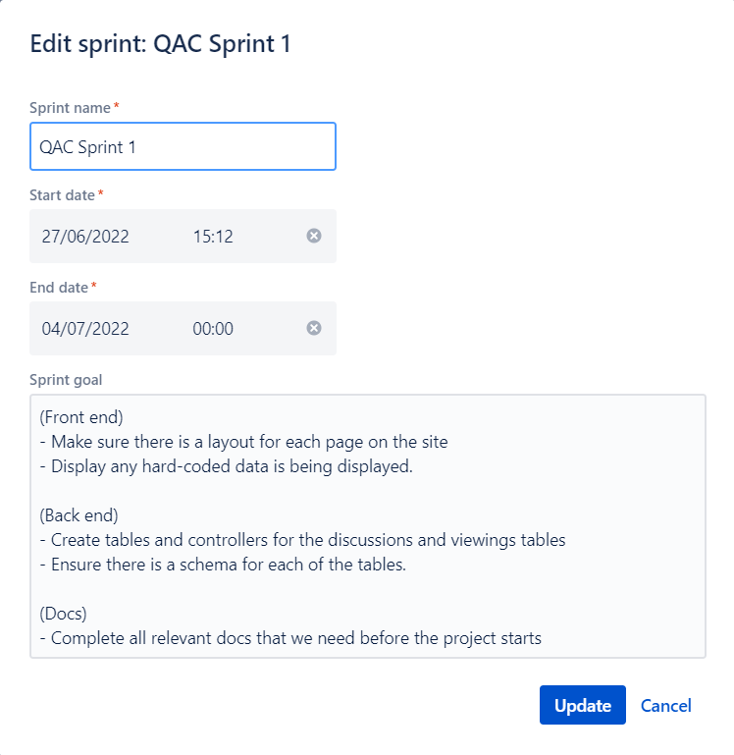
First sprint retrospective
What went well:
On track
Implemented full backend
Basic layout for nearly all the pages
Minimal merge conflicts
What went not so well:
Trying to integrate payment with paypal
Having a movie on it’s own page with its accompanying information
What we decided to focus on for next week:
Testing
Styling
Integrating payment
Search bar functionality

Slide 11
Git hub
https://github.com/tjayling/QA-Cinemas

Slide 12
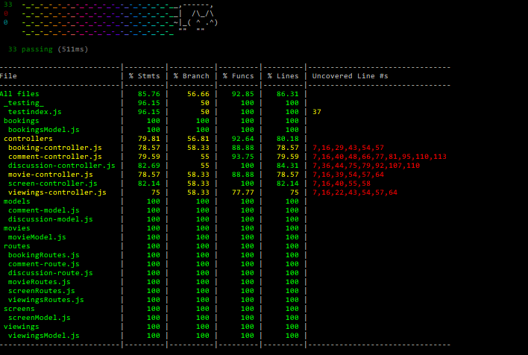
Test Coverage

Slide 13
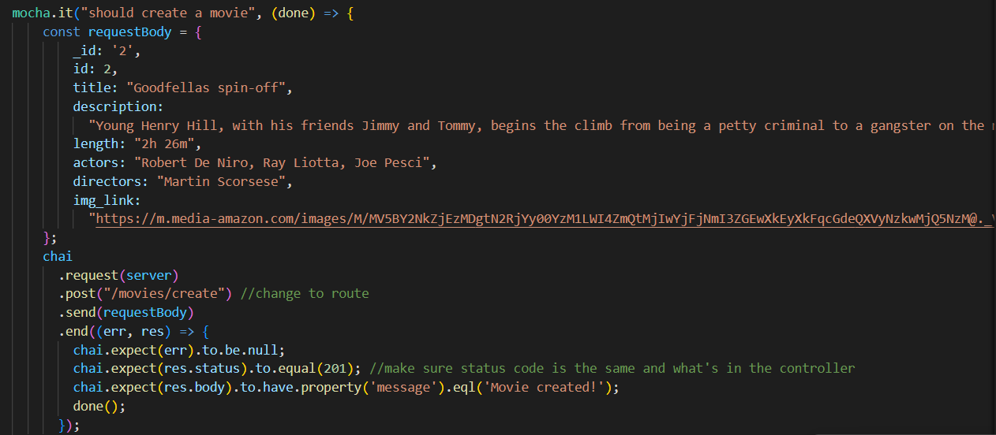
CRUD
How did you test it?
We tested our CRUD functionality with mocha, we did this for all of our components.
Did you fulfil your user stories?
Our user stories were fulfilled as we were able to execute the tasks we set up for our cinema.

Slide 14
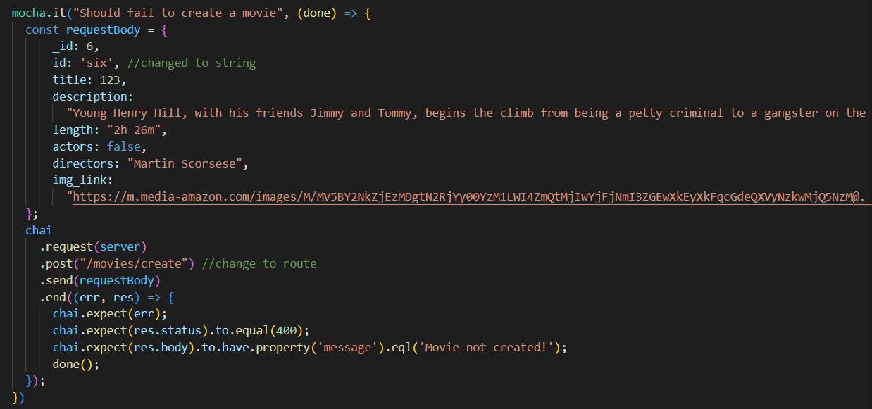
CRUD

Slide 15
Demo

Slide 16
Sprint/Project Retrospective
What we did well?
Git - keeping everything up to date and a lack of merge conflicts
Communication as a team
Testing
Got the MVP!
What went wrong?
Getting to focused on a single issue
Getting distracted by many issues
Git - FBM could have been better
Jira - sprint overran
Testing
How can we improve?
Try to do more group projects

Slide 17
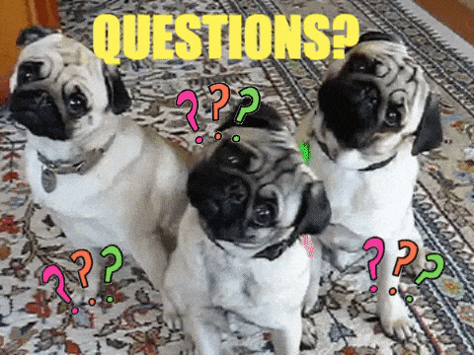
Thank you for Listening!

